Slide 1
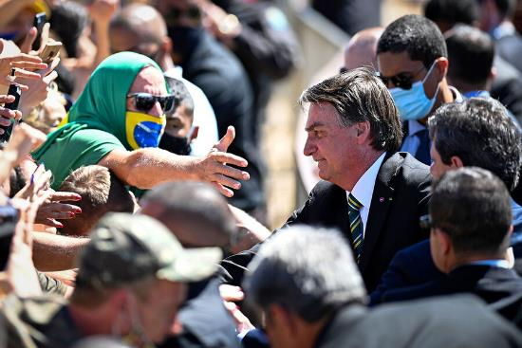
Andrés Mejía Acosta, PhD
Kings College London andres.mejia@kcl.ac.uk
@andresma_kcl
The Limits of Populism during COVID-19
Konrad-Adenauer-Stiftung
Philippines Office
6 November 2020

Slide 2
Roadmap
Latin America: a patient with pre-existing conditions
Government responses
  Covid Governance
  Presidential popularity
The ghost of populism

Slide 3
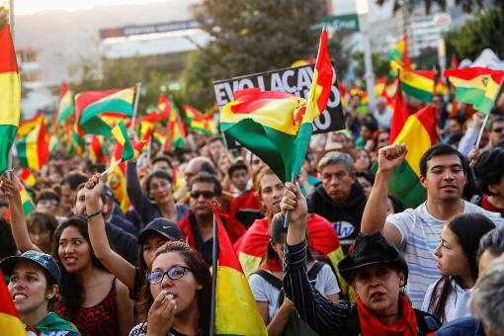
1. LATAM’s pre-existing conditions
Sluggish growth & growing debt
Commodities hangover
Labour Informality
Social protest

Slide 4
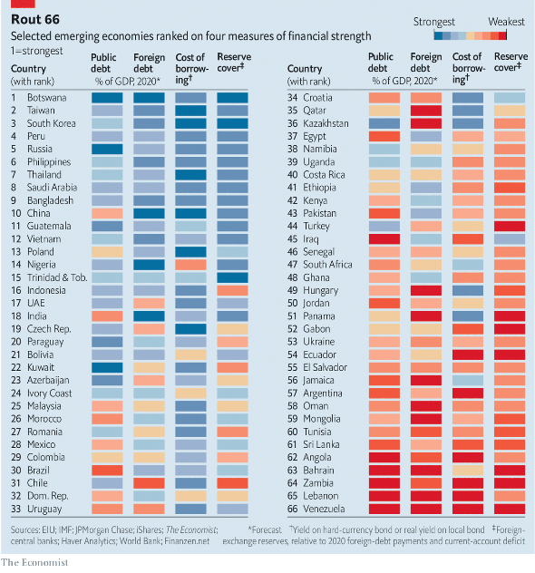
The highly indebted Latin American patients

Slide 5
2. Government responses to Covid
Countries | Lockdown Response | Presidents’ party Strength** | Regional Authority | Welfare and health provision
Argentina | Rapid/ effective | Strong - PJ | Weaker/ uniform | strong
Brazil | Mixed | Outsider – no party | Autonomies | strong
Mexico | Slow | Morena movement | disparity | limited
Source: Giraudy, Pribble, Niedzwiecki (2020)

Slide 6
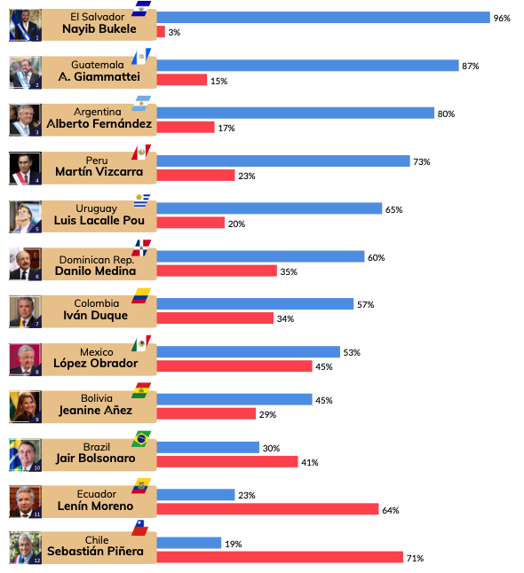
2. Presidential popularity (May 2020)
Source: Directorio Legislativo 2020

Slide 7
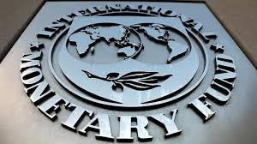
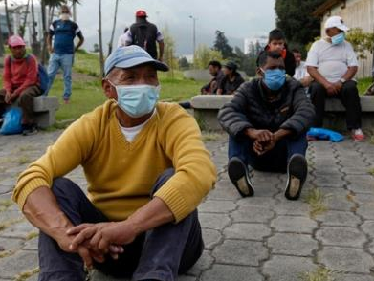
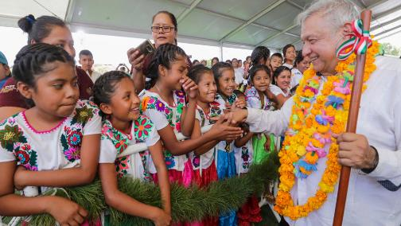
3. The Ghost of Populism
The cost of economic recovery
Who pays for adjustment, who wins and who loses?
The populist temptation

Slide 8

Gracias! Thank you! andres.mejia@kcl.ac.uk
@andresma_kcl
The Limits of Populism during COVID-19

